Slide 1
STUDENT ATTENDANCE MONITORING USING FACIAL RECOGNITION IN A CLASSROOM
Team members
K CHANDRASEKARAN RA1711004040028
S AATHITH RA1711004040030

Slide 2
Existing problem
Student’s attendance in the classroom is a very important task
The existing method of taking attendance consumes a finite of amount of time which can be used for other productive action.
We are focused on addressing this problem on schools and universities only.

Slide 3
Motivation
We found this problem in many universities
We want a reliable system which identifies which student is present in the classroom and gives the attendance based on his presence
This system must not be complex and very easy to interact with it

Slide 4
Existing Recognition systems
The systems can be broadly classified :
Systems that uses human characteristics like fingerprint
Systems that uses unique objects that the person carries like ID card

Slide 5
Fingerprint based recognition system
Distracts the attention of students during lecture time
Queuing takes place

Slide 6
RFID based recognition
Possibilities that Fraudulent may occur
Cheat the system by giving proxy (for example a student misuse it by wearing another student’s ID card )

Slide 7
IRIS based recognition system
Cant use a regular camera
Visible light must be minimized for maximum accuracy

Slide 8
Proposed work
Attendance is monitored and marked present or absent depending upon the presence of the student inside the class at the particular time of lecture
Our solution uses a camera that takes photo of a group of students, and then uses facial recognition for marking attendance for a student
We found that facial recognition overcomes some of the problems that exist in the previously mentioned attendance systems
Our solution makes sure that there is a minimal interaction between students and the attendance monitoring system

Slide 9
Facial recognition
Any facial recognition has 2 steps
Facial detection – the process of finding a face in a given image
Facial recognition – the process of identifying the person from the image of a face (example : face id in apple )
The process of facial recognition occurs in a separate computer as the burden on the camera system must be reduced

Slide 10
Hardware
Camera is installed on the classroom
The role of the camera is just to take pictures
But the process of facial recognition takes place in another computer

Slide 11
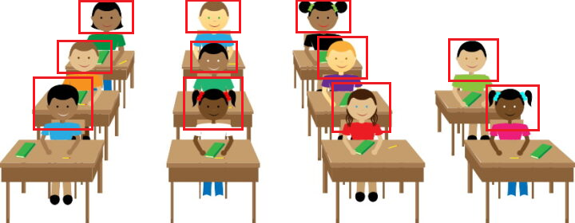
Facial recognition in class – an idea

Slide 12
Thank You

